Slide 1

The Parent’s Guide to
Childbirth & Newborn Care
Birth Options • Reflexes • First Care
Patryck Jones • EDU 182
September 10, 2026
1
Notes:
Sources: Course assignment prompt provided by instructor.
Images: photo-style assets created for this presentation.

Slide 2

EDU 182
Your Birth Team
Doctor / OB-GYN
Midwife
Doula
Medical provider who manages pregnancy and birth, especially higher-risk situations or surgery.
Trained medical provider focused on prenatal care and birth, often with low-intervention care.
Non-medical support person who offers comfort, breathing help, encouragement, and birth-plan support.
Why it matters: The right team can explain your choices, speak calmly during stressful moments, and help you make a backup plan if birth changes.
2
Notes:
Sources: ACOG: FAQs on labor, delivery, and pain relief. | ACOG/clinical education: doulas provide emotional and physical support, while clinicians provide medical care.
Images: photo-style assets created for this presentation.

Slide 3

EDU 182
Managing Pain: Anesthetics
• Epidural: medicine goes through a small tube in the lower back to reduce labor pain while the parent stays awake.
• Spinal block: often faster and used for some C-sections; it numbs the lower body.
• Local anesthesia: numbs a small area, like for stitches.
• Other options: IV pain medication, nitrous oxide, breathing, movement, water, massage, and support.
Why choose it?
Why skip it?
It can make labor more comfortable, especially during long labor or surgical birth.
Some parents want more movement or prefer fewer medicines and procedures.
3
Notes:
Sources: ACOG FAQ086: epidural, spinal block, local anesthesia, systemic medications and possible side effects.
Images: photo-style assets created for this presentation.

Slide 4

EDU 182
Comparing Birth Settings
Hospital Birth
Home / Birth Center
Pros: emergency care, surgery, monitoring, specialists, more pain-control options.
Cons: can feel less personal, more rules, and more routine interventions.
Pros: calmer, more private, low-intervention feel, personal routines.
Cons: less immediate emergency care and may require transfer if complications appear.
Best question: “What setting makes me safe, respected, and supported?”
4
Notes:
Sources: ACOG patient resources: birth planning should include health status, risk level, and access to emergency care.
Images: photo-style assets created for this presentation.

Slide 5
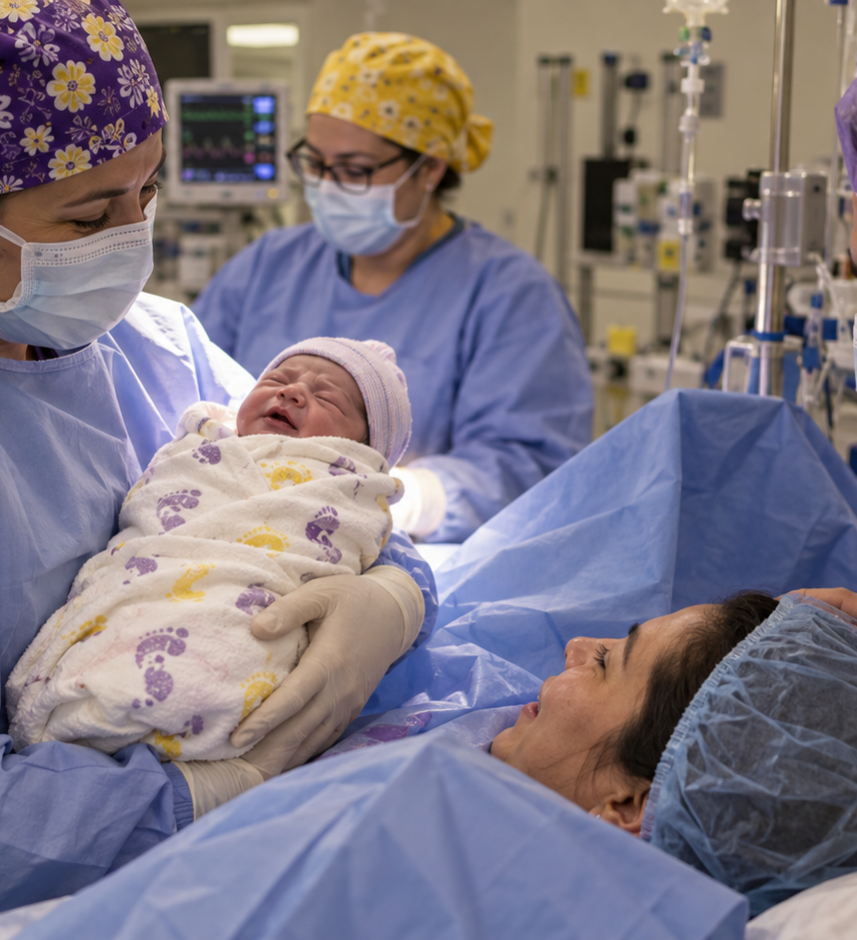
EDU 182
The Backup Plan: C-Section
What is it?
A C-section is a surgical birth. The baby is delivered through openings made in the parent’s abdomen and uterus.
Why might it be needed?
1
Baby in distress: the baby’s heart rate or oxygen signs worry the medical team.
2
Placenta problems: placenta previa or severe bleeding can make vaginal birth unsafe.
A C-section is not a failure. It is sometimes the safest way to protect parent and baby.
5
Notes:
Sources: Cleveland Clinic: placenta previa can make C-section the safest delivery option. | Merck Manual: delivery is indicated for unstable mother/fetus or nonreassuring fetal monitoring in placenta previa.
Images: photo-style assets created for this presentation.

Slide 6

EDU 182
Understanding Your Newborn: Reflexes
Rooting
Sucking
Moro / Startle
When the cheek or mouth is touched, baby turns toward it. This helps baby find food.
When something touches the mouth, baby begins to suck. This supports feeding.
A loud sound or sudden movement can make baby throw arms out, then pull them back in.
Call the pediatrician with concerns, but these reflexes are part of normal newborn development.
6
Notes:
Sources: MedlinePlus: infant reflexes are automatic responses and include rooting, sucking, Moro/startle, and grasp reflexes.
Images: photo-style assets created for this presentation.

Slide 7
EDU 182
Welcome Home: Quick Start Guide
Skin-to-Skin
The 5 Senses
Safe Sleep & SIDS
Hold baby against your bare chest. It supports bonding, helps with temperature, calms baby, and can help parents feel connected.
Newborn vision is blurry and close-up. They recognize familiar voices and often respond to higher voices, soft talking, and gentle touch.
Newborns sleep in short stretches. Always place baby on the back, on a firm flat surface, with no pillows, blankets, bumpers, or stuffed animals.
SIDS (Sudden Infant Death Syndrome) is most common during the first 6 months of life, especially between about 1 and 4 months. Researchers believe it may involve problems with the way some babies wake up or respond when their breathing or oxygen level changes during sleep.
7
Notes:
Sources: CDC Safe Sleep: place babies on their backs for naps and night; use a firm flat surface; keep soft bedding, pillows, bumper pads, and toys out of the sleep area. | MedlinePlus: newborn senses include close-up blurry vision and response to sounds/voices.
Images: photo-style assets created for this presentation.

